Slide 1
Planning the Possible
How Schools Can Use Stimulus Dollars for Lasting Impact

Slide 2
American Recovery and Reinvestment Act
$787 billion total and $98 billion for education
Purposes of education funds:
backfill state budgets
prevent teacher layoffs
implement reforms
“If all we do with the money is save jobs, we’ve failed.” —U.S. Secretary of Education Arne Duncan

Slide 3
ARRA Education Funding
Funds should be used in four reform areas:
standards and assessments
data systems
turnaround of the lowest-performing schools
teacher effectiveness and the equitable distribution of qualified teachers

Slide 4
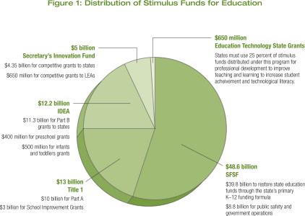
ARRA Education Funding

Slide 5
ARRA Important Considerations
Avoid the funding cliff, or recurring costs past the September 2011 spending deadline.
Spending on capacity-building reforms will help schools and districts get the most out of their stimulus dollars.
This is a unique opportunity to show policymakers and the public the effects of additional resources.

Slide 6
What Is Capacity-Building Professional Development?
A comprehensive and customized approach.
Focuses on specific pedagogical practices, leadership practices, or content areas.
Develops a core group as local experts for sustainability.
Develops core group’s capacity to support job- embedded professional learning.

Slide 7
Bringing it Together: ARRA and Capacity-Building PD
Effective teachers and school leaders rank first and second among school-related factors that affect student learning.
Capacity-building professional development will ensure the lasting effects of the education stimulus reforms, which translates to long-term benefits for our students.
Capacity-building professional development is cost-effective after the stimulus funds are exhausted.

Slide 8
Economic Stimulus Resources
You can find the latest resources on the stimulus package at www.ascd.org/ARRAresources. Other ASCD and federal resources are below.
ASCD Resources
Planning the Possible: How Schools Can Use Stimulus Dollars for Lasting Impact
Stimulus Web Seminar
Podcast: Understanding the Stimulus
Funding: State by State
Stimulus Summary(PDF)
Explanation of State Fiscal Stabilization Fund (SFSF)
Department of Education Resources
District Allocations for Title I and IDEA for All States (PDF)
School Modernization
Guidance Document on the Use of ARRA Funds to Drive School Reform and Improvement

